Slide 1
Married
to the Mob
(programming)
Notes:
Welcome to this session on MP
Thank you for being here
MP is a technique I try to use all the time now and if not fall back to using strong style pairing. I have used it at work, in coding dojos and even teaching kids to program.

Slide 2
hey hi hello
derek graham @deejaygraham
Notes:
My name, twitter handle.
This is a big topic so I’ll try to cover as much as possible.
If you want to talk after. I am around all day - grab me to chat.

Slide 3

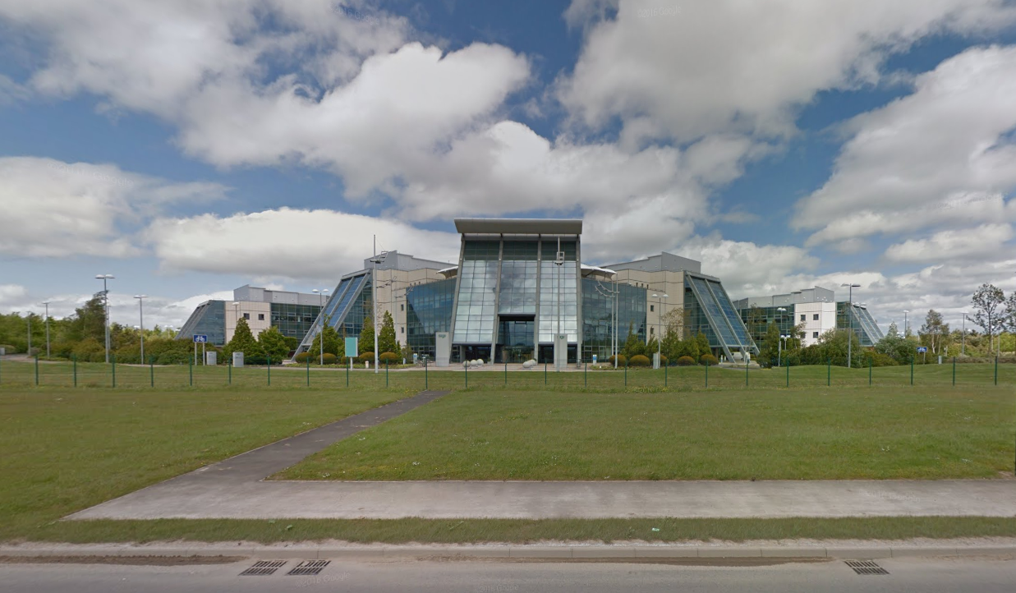

Notes:
Principal Dev at Sage in Newcastle

Slide 4
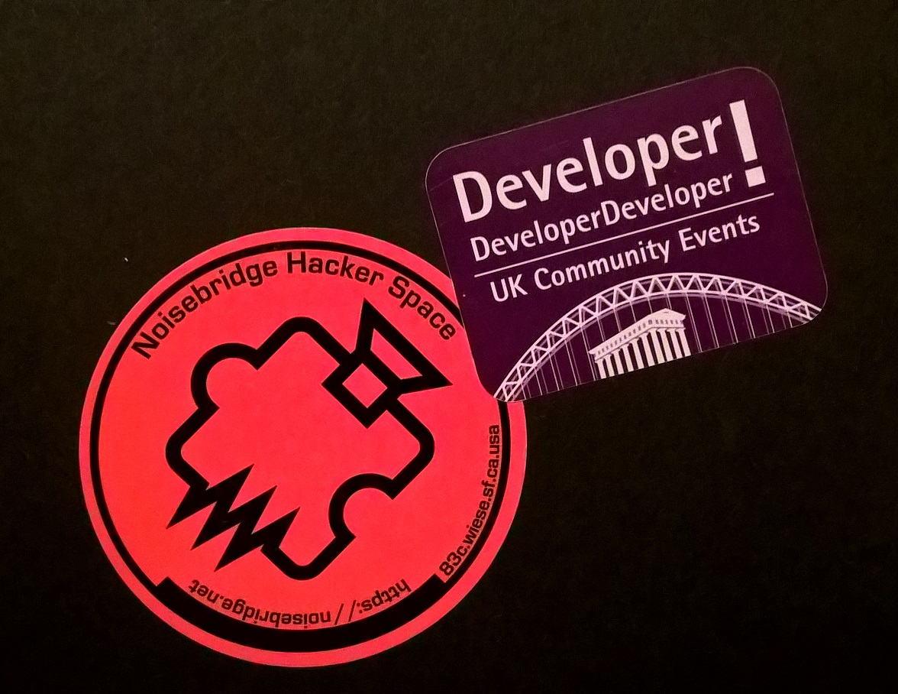
Notes:
Co Org of two developer meetups in Newcastle Agile North East and NE Bytes
Running dev meetups and coding dojos at work where we can be programming as a group larger than a pair lead me to evolve a similar approach to MP which meant I recognized the possibilities when I became aware of it about 3 years ago.

Slide 5
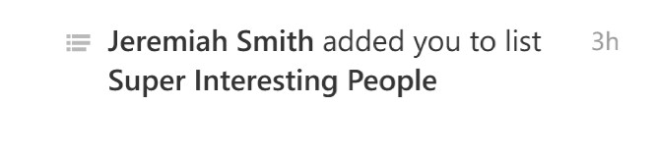
Notes:
Also I am super interesting…
if you believe twitter and I don’t have the courage to go and look at that list.

Slide 6
The characters and events
depicted in this
presentation are fictitious.
Any similarity to actual persons, living or dead, is purely coincidental
Notes:
A disclaimer before we go any further. Wanted to show actual team photos but Newcastle folk are very shy, they don’t go out much.
Couldn’t get anyone to pose - some scenes
are reconstructed for narrative purposes.

Slide 7
Mob?
Notes:
Let’s talk about the road to mobbing

Slide 8
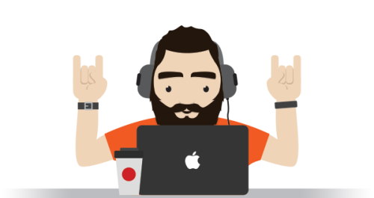
Notes:
Way back in history,
We had Awesome Ninja Rockstar Pirates Developers.
Individual contributors largely with their own specialisation and implied silos.
Long feedback cycles and large batches of work

Slide 9
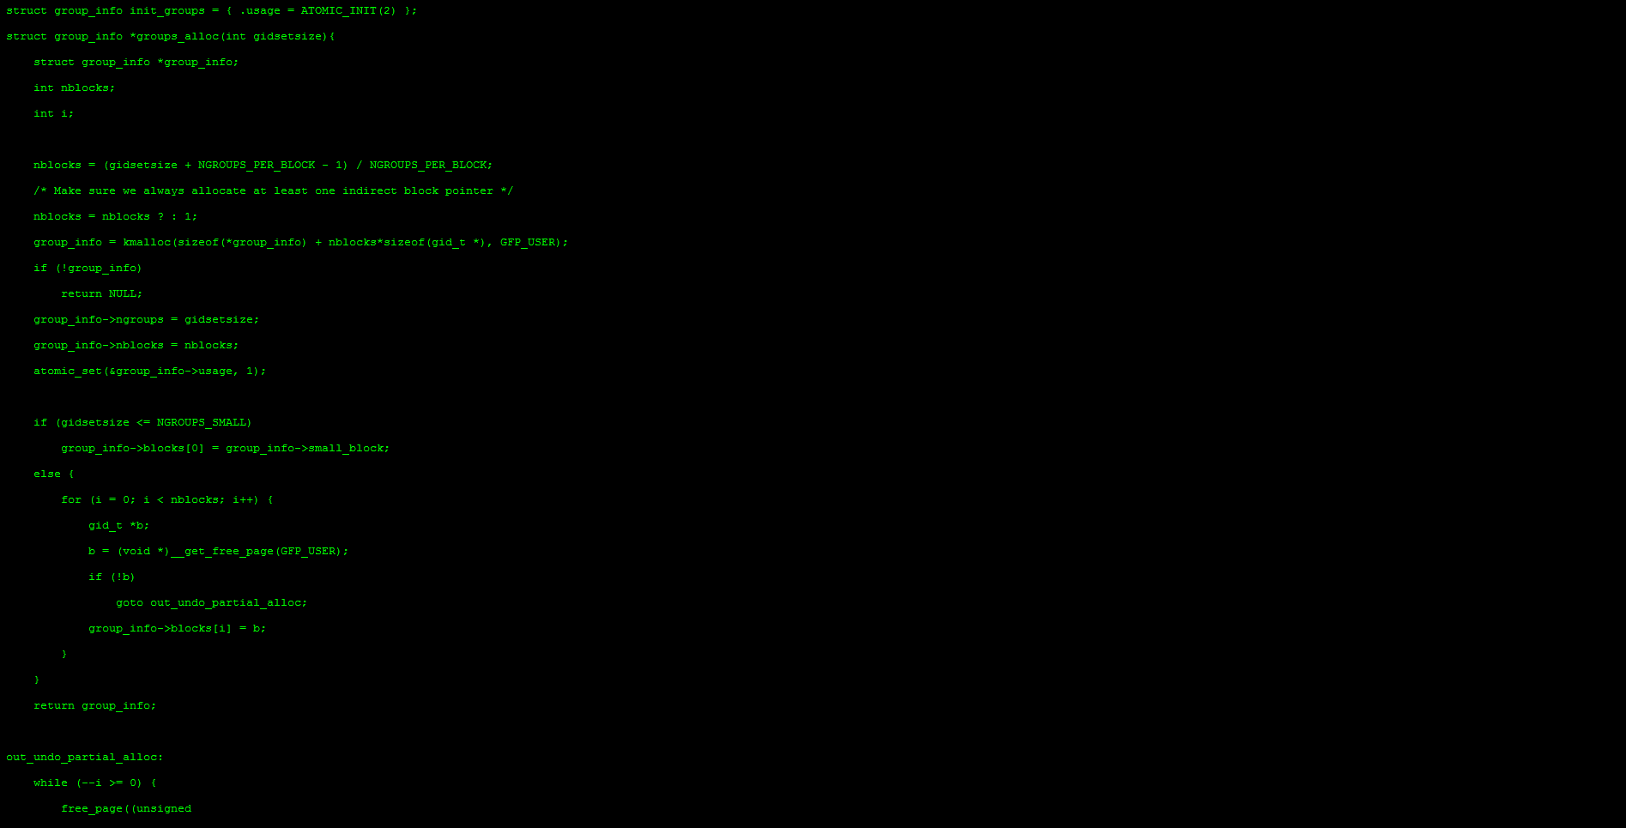
Notes:
Turn Coffee and an Awesome Idea into green on black code.
More code == better
And we’ll take all the code from everyone on the project and jam it all together at the end and ship it

Slide 10
90% done
Notes:
Classic project management problem. Developer reports 90% done, only last 90% remaining.

Slide 11
PROCESS
Notes:
To combat this, we attacked the poor dev with more process, code reviews, status meetings - when will you be done?
In late 1990s, early 2000s Kent Beck made up a new thing - XP

Slide 12
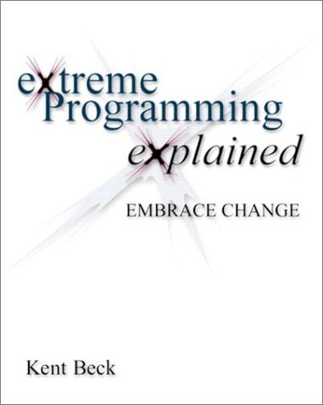

Slide 13
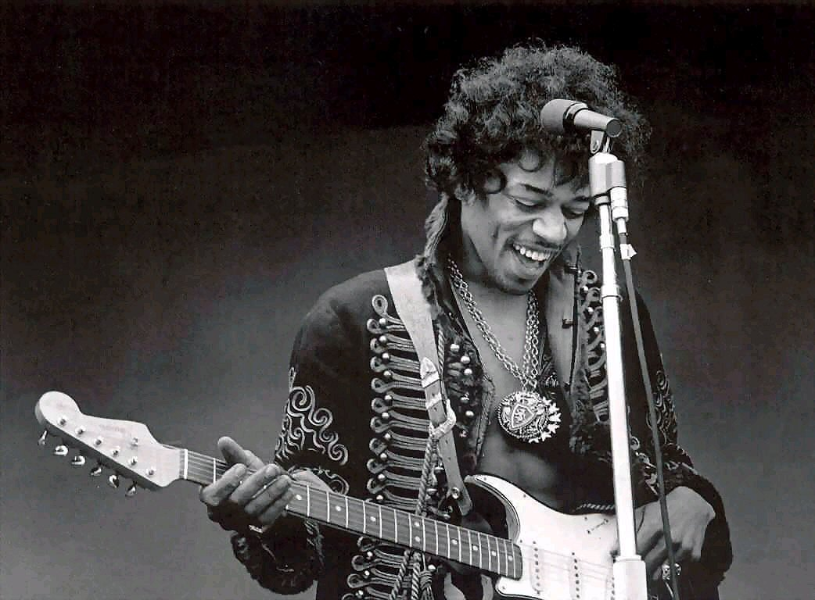
are you
XP?
Notes:
Ask Audience Agile - who is practicing xp
Regularly pairing?

Slide 14
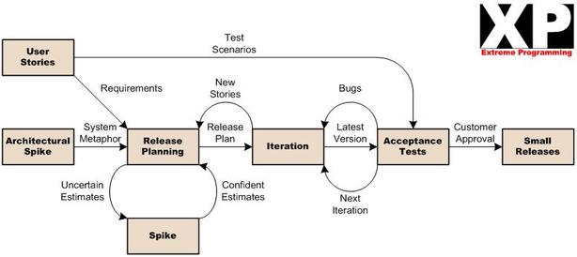

Slide 15
XP Engineering Practices
Continuous Integration
Pair Programming
Test Driven Development
Simple Design
Refactoring
Collective Code Ownership
Sustainable Pace
Notes:
Pair Prog, TDD, CI builds all Aimed at working in smaller batches, getting faster feedback.
Pair works on a problem and maybe pairs switch around to spread knowledge.
Still requires Standups, Meetings.
Another approach is one we stumbled on a couple of years ago…

Slide 16
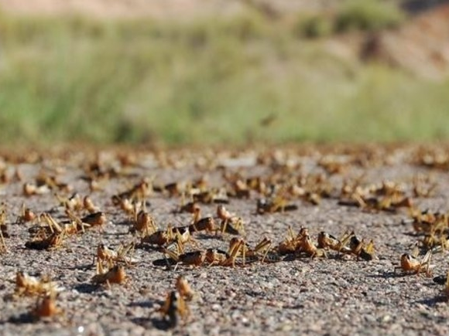
Swarming
Notes:
In pairs, two people work on one thing and another pair will usually work on something different. Swarms - all the team work on one problem at the same time.

Slide 17

Notes:
Given an puzzle. Each team member owns piece of the puzzle and split to work on it individually or in pairs but come together regularly to integrate and test.

Slide 18
C#
Test Script
DB Admin
JSON
HTML
Deploy Script
Notes:
Less specific to traditional roles - someone could be writing a test, someone writing a piece of front end, someone writing backend, database, deployment. All in service of one problem. Fix that problem and move on to next.

Slide 19
“Swarming … is the first time we’ve felt like a genuine team instead of individuals all working for the same manager.”
– Our Team
Notes:
love this quote from a retrospective…
Felt much more like a sports team - helping each other out.

Slide 20
Begin {
Notes:
Mobbing began by accident…

Slide 21
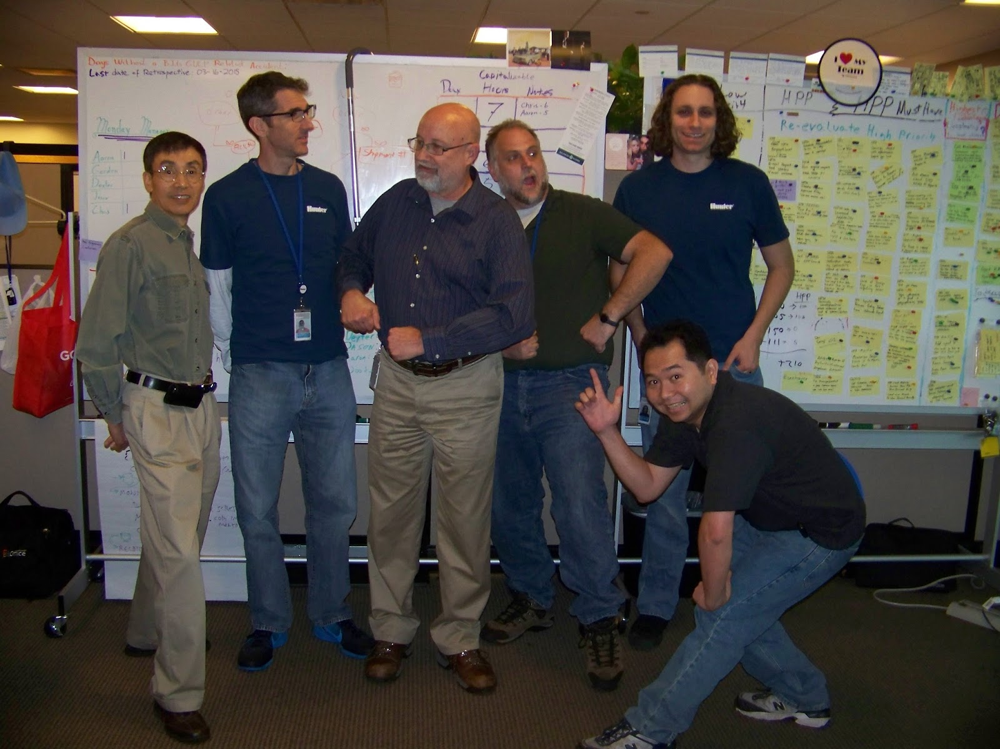
Notes:
Hunter - quality and shipping
Deliberate Practice - Learning Hour - safe space.
Experimenting with writing tests, patterns, katas
Went back to individual working at end of hour.
Found they preferred working as a group
Decided to experiment
Named it Mob as next highest collective noun for devs Pairing -> Swarming -> Mob

Slide 22
“All the brilliant people, working on the same thing,
at the same time,
in the same space,
and at the same computer.”
–Woody Zuill
Notes:
He says it best…
And when we say all we mean devs, testers, Bus analysts, customers, ops.
Everyone who is interested and feels they can contribute.

Slide 23
Mob = XP++
Notes:
Mob is like the next step up from pairing.

Slide 24
“ Mobbing would be in the XP book
(if they'd thought of it)”
–Rachel Davies (Agile Coach)
Notes:
Rachel Davies Agile Coach says…

Slide 25
Mob !=
Notes:
Quickly point out - it’s not a chance for someone to program with an audience.

Slide 26

!Mob
Notes:
Quickly point out - it’s not a chance for someone to program with an audience. Getting back to rockstar territory. Showing off what you know, about true collaboration and sharing.

Slide 27
Notes:
it’s not a chance to program with an audience - showing off how much you know.

Slide 28
hello, Mob
Notes:
Some simple things to get started and write our first hello world…

Slide 29
One set of Input Devices (keyboard and mouse)
Everyone can see the code
Everyone has a role
Roles rotate over time
Notes:
Fundamentals are…

Slide 30
Large Screen or HD Projector
Keyboard & Mouse
Timer
Whiteboard
A Problem
Notes:
To get started, you will need…
Timer to make sure we rotate roles regularly.
Whiteboard to make notes for stuff to pursue later.
Problem or what’s the point?
Mob size will determine size of workspace.
Usually 3-6 people.
Also implies comfortable seating

Slide 31
4-6 people
comfortable space
let everyone speak
take time to discuss
2-3 times per week
1-2 hours each

Slide 32

* reconstruction
Notes:
team gathered around a single computer.
awesomeness (not actual team) for dramatic reconstruction.

Slide 33
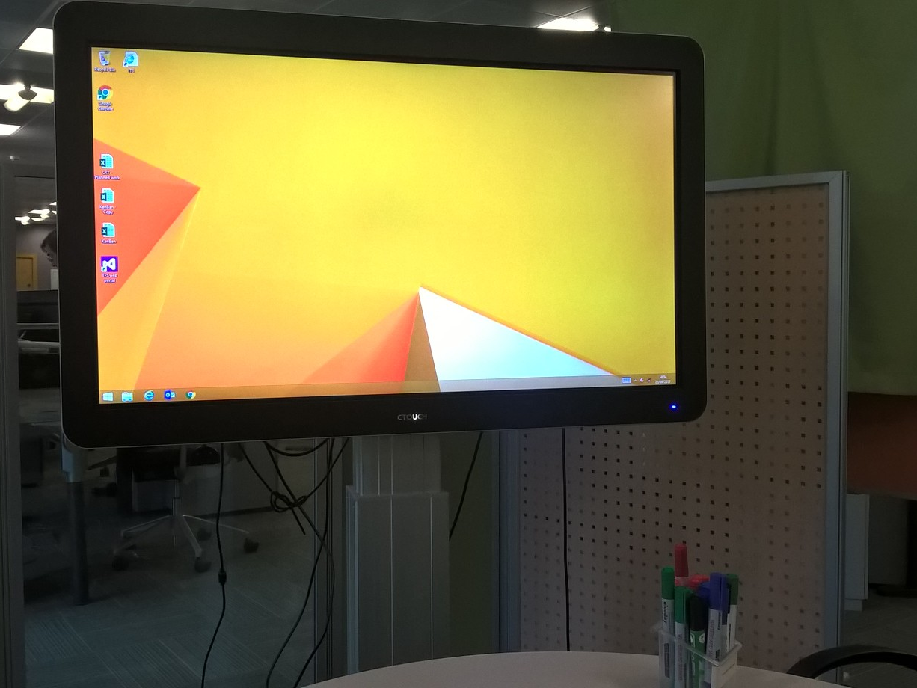
Notes:
Big TVs
RDP,
Local laptop
Seats arranged around desk in closed off area.

Slide 34
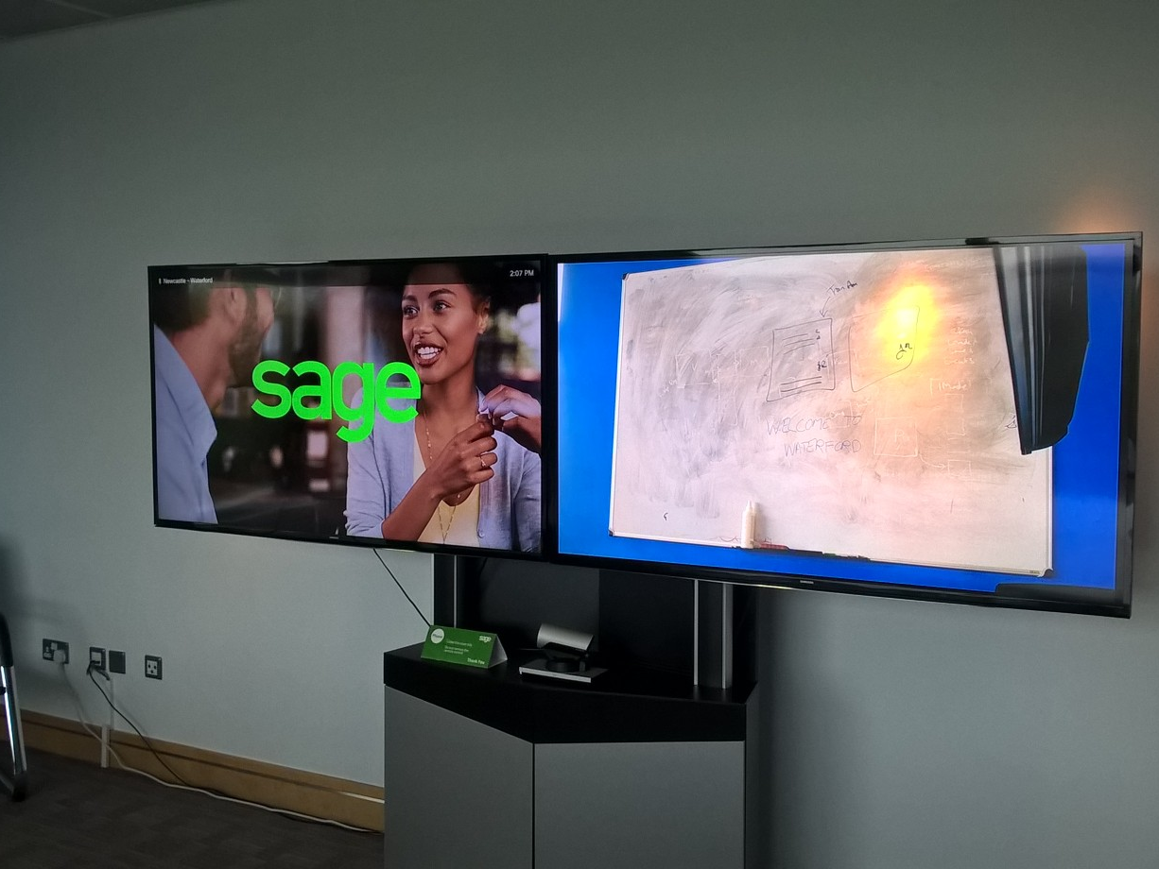
Notes:
remote mobbing, teleconference - big screen - one for code, one for whiteboard so that remote can see what we see.

Slide 35
Notes:
Other computers are allowed
admin,
dev ops,
deployment,
testing,
email,
research

Slide 36
Mob Roles
Notes:
MP has only two roles but they are a bit different from what you would expect.

Slide 37
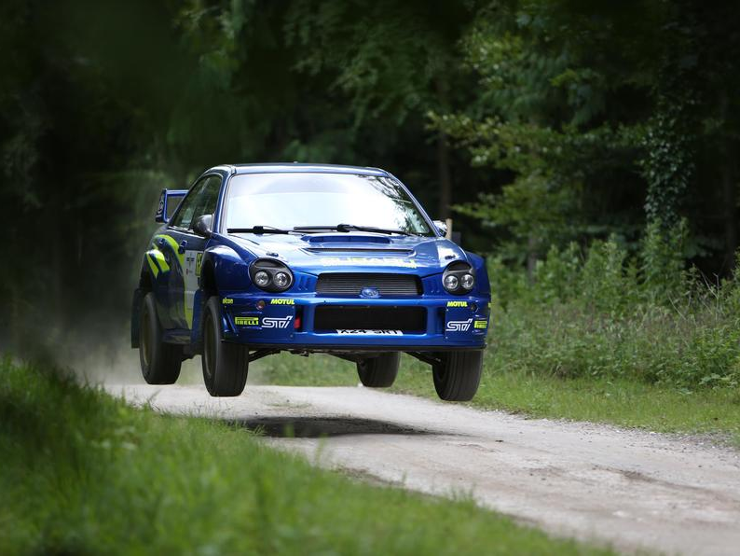
Notes:
Rallying - is a two person sport.
Driver - short range focus - pedals, gears, steering
Navigator - Longer range - hills and bends
Each specializes, don’t swap.
XP borrows this.

Slide 38
Navigator
Driver
Notes:
In XP, there are two people sitting at a single computer and sharing a keyboard. One driver and one navigator.
Swap as required and roles reverse.

Slide 39
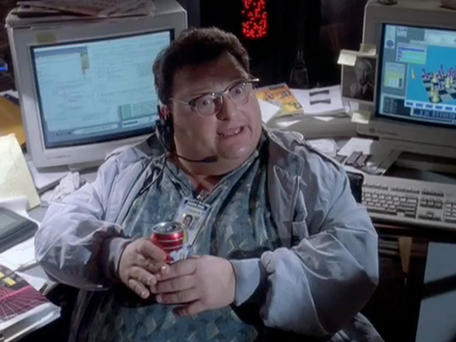
Driver
* reconstruction
Notes:
The driver is the person with an idea of how to solve the problem and types and hopefully narrates.
Thinking about making current code compile. focussed on syntax etc.

Slide 40
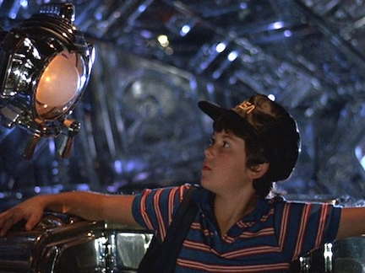
* reconstruction
Navigator
Notes:
The Navigator (a small boy) sitting next to him thinking about next test, higher level of abstraction.

Slide 41
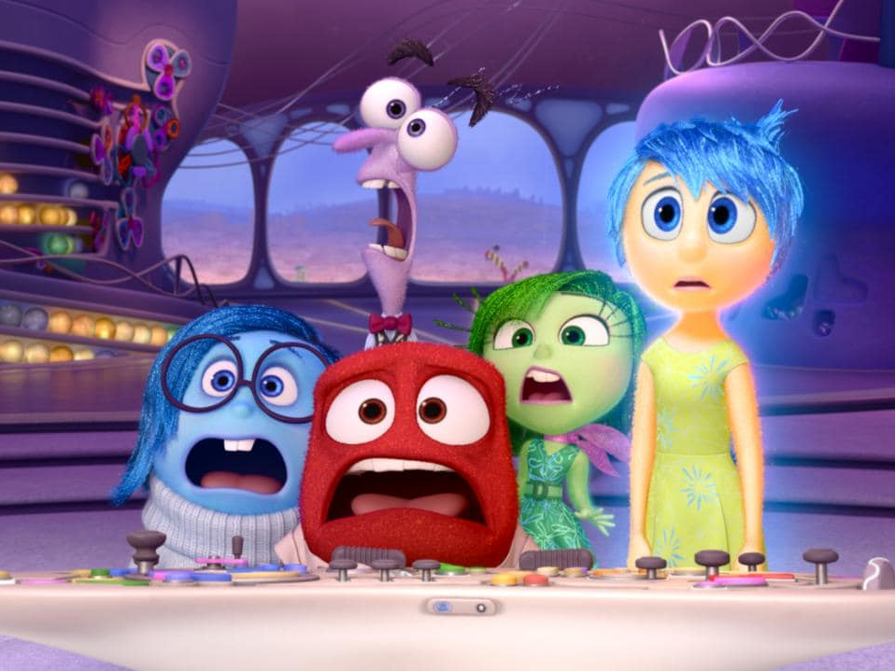
* reconstruction
Notes:
MP turns this idea inside out.
Single driver is writing code but the direction comes from the (multiple) Navigators.

Slide 42
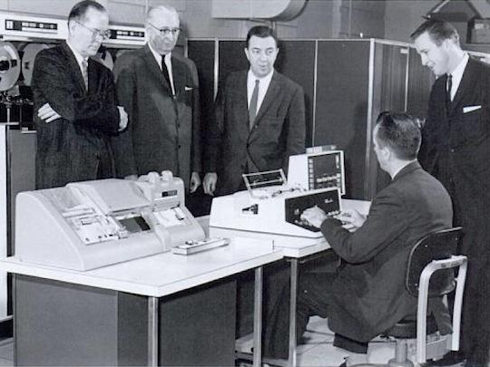
* reconstruction
Notes:
Here’s what that looks like.
Single input device, code is here, here, here…
Driver sits at keyboard, navigators arranged around.

Slide 43
Facilitator?
Navigator
Navigator
Navigator
Driver
* reconstruction
Notes:
Driver
Navigators
Facilitators? - New and Large groups.

Slide 44
Mob Rules
Notes:
There are some rules to make Mobbing work smoothly

Slide 45
Kindness
Consideration
Respect
“Yes and…” ideas
Strong-style Pairing
Notes:
Spending a lot of time together and it’s easy for resentment and anger to build up and cause unhappiness
name calling, fundamental attribution error - i broke the build, you broke the build.
Yes and improv, don’t kill someone’s idea

Slide 46

Notes:
if you feel like you have to be a saint like Mr Rogers to be kind, considerate, respectful…

Slide 47
“We decided for one day to pretend to be kind, considerate and respectful. And then we decided to do it again.”
– Woody Zuill
Notes:
Pretend, maintain that pretence for a short time.
Over time, that becomes reality.
Something else to adopt this mindset
ASK Anyone doing retrospectives in their process?
Norm Kerth wrote the book

Slide 48
“Regardless of what we discover, we understand and truly believe that everyone did the best job they could, given what they knew at the time, their skills and abilities, the resources available, and the situation at hand.”
–Norm Kerth
Notes:
Mantra we use in our retros to set the right frame of mind. Norm Kerth’s retro prime directive.

Slide 49
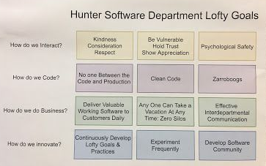
Notes:
Hunter went on to create a set of Lofty Goals with KCR at top left.

Slide 50
if you aren’t learning or contributing, find a better use for your time.
Notes:
No coercion.

Slide 51
Mob Roles, 2
Notes:
Let’s talk a bit more about the roles in Mobbing.

Slide 52
Driver
Notes:
I think Driver (from XP) is too active - in MP the driver is a more passive role

Slide 53
Driver Typist
Notes:
so I am coming round to using typist.
After all they take input from surroundings and do something with that request. If you don’t like typist how about…

Slide 54
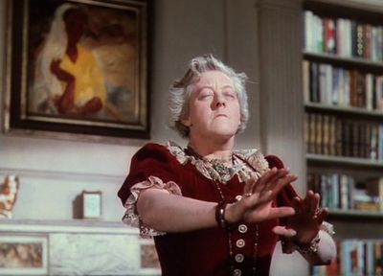
Notes:
communing with the spirit of the mob to divine what the next piece of code is.
Like Madame Arcarty from Blythe Spirit.
If you are more technically minded…

Slide 55
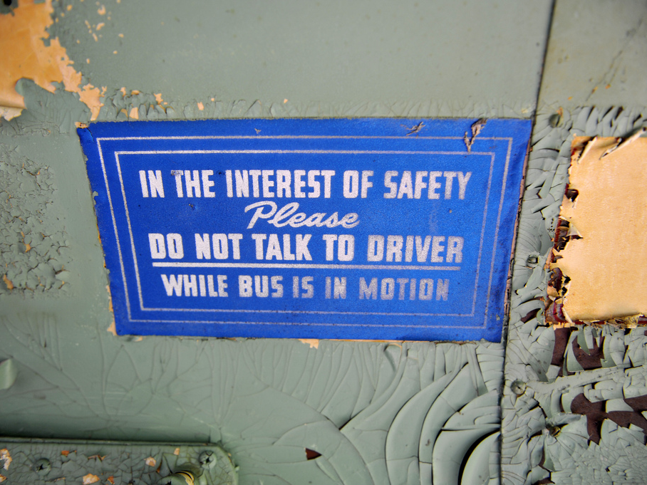

Slide 56

Cortana for Code
Listen to the mob
Translate that into code
There is no 3
Notes:
Let’s call it

Slide 57

Siri for Syntax
Write the Code
Talk about the Code
Rollback?
Patience
Incomplete Understanding
Notes:
Sit with incomplete unfinished stuff. Difficult thing to do for someone who wants code to compile.

Slide 58

Alexa for Algorithms
Notes:
Ok, I’m going to stop there.
Important thing to remember is…

Slide 59
If you have
the keyboard,
you can’t have
the ideas

Slide 60
Mob % Typist
Notes:
The remainder of the mob … are navigators

Slide 61
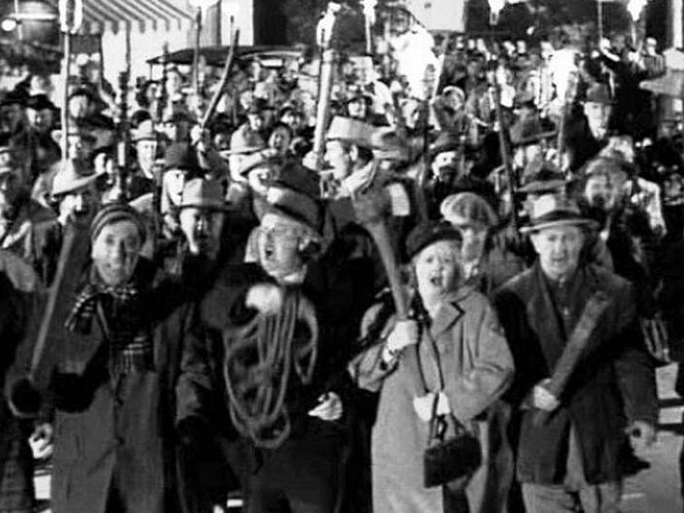

Slide 62
Collaborate & Discuss
What is the next step?
Talk to the Typist
Park other issues
Notes:
Discussion
Agree next step
Give clear instruction to the typist - may need a nominated person
Whiteboard

Slide 63
The team is like an extended brain,
it needs to talk out loud to know what it thinks
Notes:
There’s lots of talking and it can get quite loud but it is important to do it. We’ll come back to this in a bit.

Slide 64
Rotation

Slide 65

Typist
Navigator
Navigator
Notes:
Just like in pairing, roles swap around in the team.
Person types for a little while, then they become a navigator and someone who was a navigator becomes a new typist. Everyone rotates through the typing seat. No second goes.

Slide 66
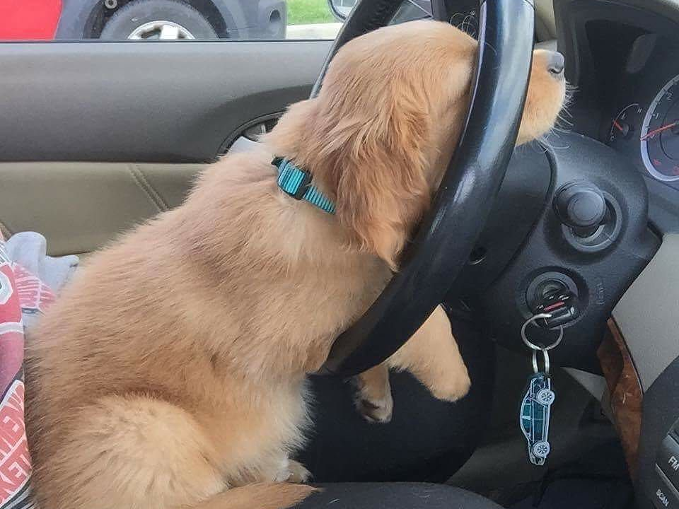
* reconstruction
Notes:
Doing anything for a time can be tiring.
Can be done organically - finish a thought before changing
But monitor to make sure nobody is hogging one role.

Slide 67
Facilitator?
Navigator
Navigator
Navigator
Typist
Timer
* reconstruction
Notes:
Enclosed area? Can use a mechanical egg timer
Use phone or use a mob timer - browser

Slide 68
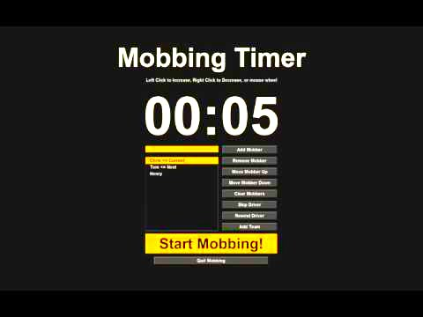
Notes:
here’s an example

Slide 69
Strategies
Notes:
line numbers
10.5
variable naming
white board/pad

Slide 70
Strong Style
Pairing
Notes:
Thing everyone notices about MP is the number of people you have gathered in one space. But there’s a technique at the core of MP that not many people talk about.

Slide 71

<strong>
</strong>
Notes:
Obligatory fruit joke.
this technique is the game changer
use on monday morning
what i use at work as much as I can

Slide 72
Have you ever had a bug?
Notes:
how did you fix it?
Don’t have to tell me now.
What about if you didn’t know what the problem was?

Slide 73
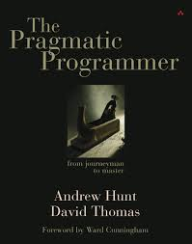
Notes:
2000 ish
lots of good tips
get it and read it if you haven’t already.

Slide 74
Notes:
One technique was talk to rubber duck. Thinking through a problem can solve some problems but when you really get stuck, vocalizing your perceived problem and listening to yourself you can often identify the problem before you reach the end of your sentence.
I have been doing this since I read about it.
Short cut if do it in own head. SF Cory Doctorow corpus collossum - what it was but not what it was called. Speaking out loud.

Slide 75
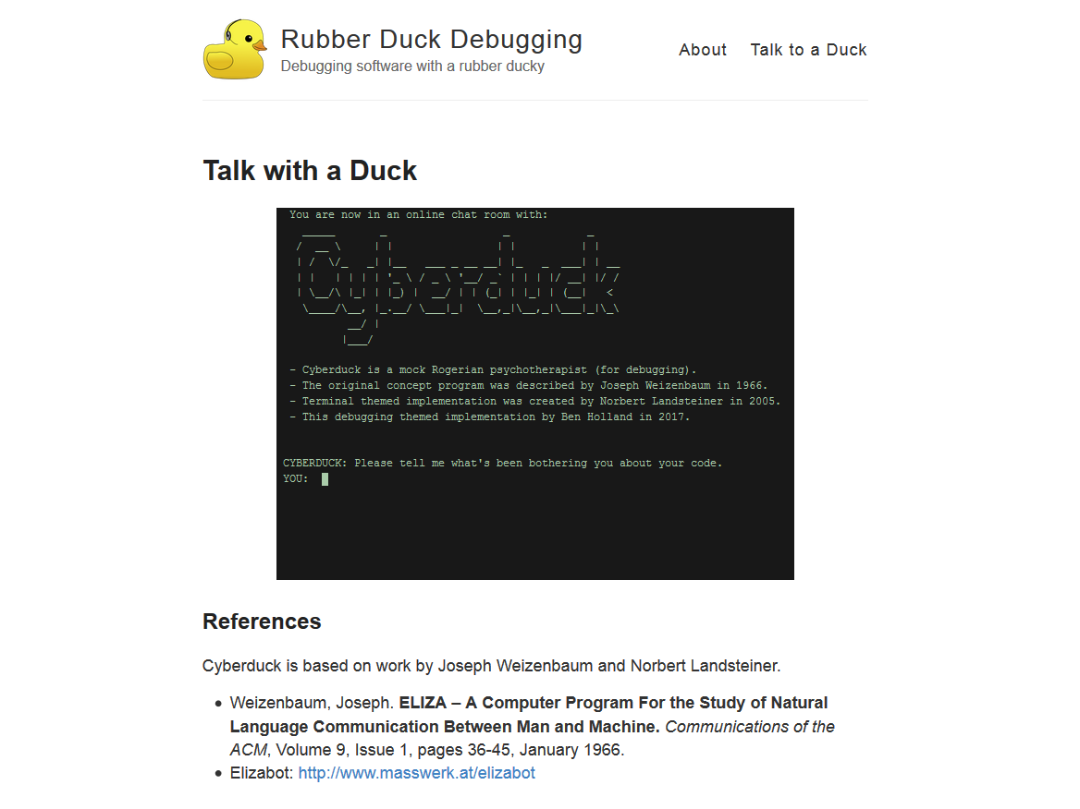
Notes:
Eliza bot repackaged as a code analysis tool

Slide 76
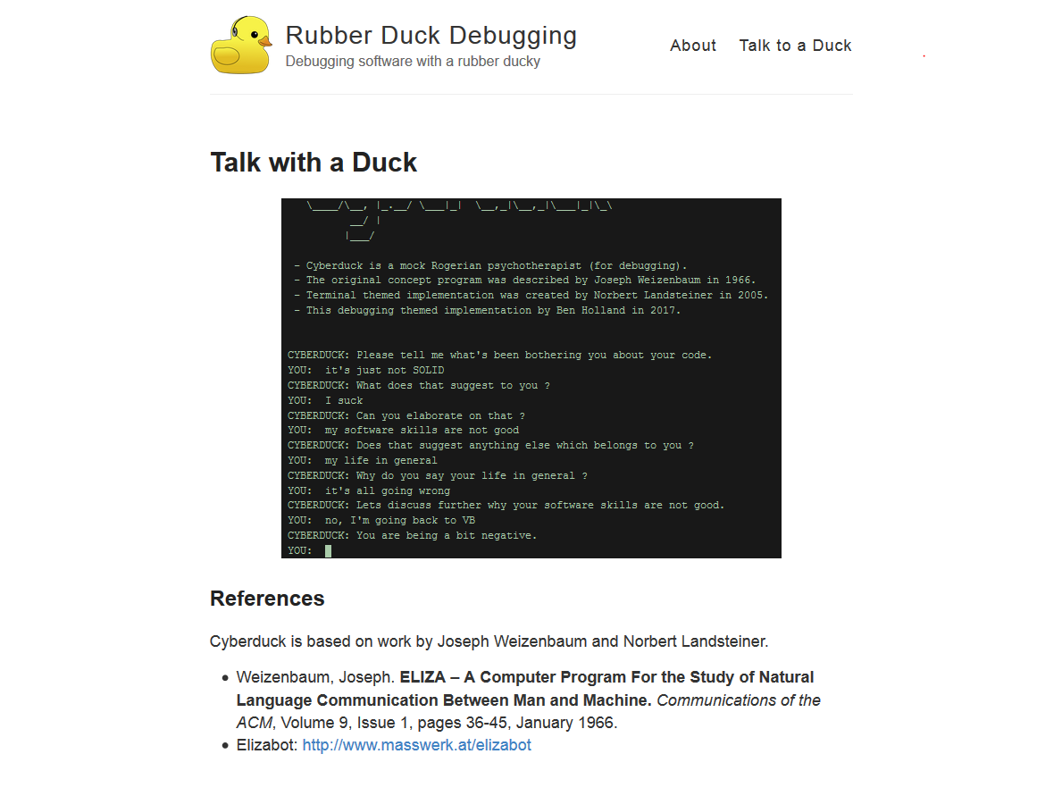
Notes:
Doesn’t work as well. Speaking and listening back is the thing that works.

Slide 77

Notes:
One of the people working at Hunter with Woody
formalized this verbalisation into SSP
And it is something you can do as when pairing, it’s just used more in MP context when interacting with a typist.

Slide 78
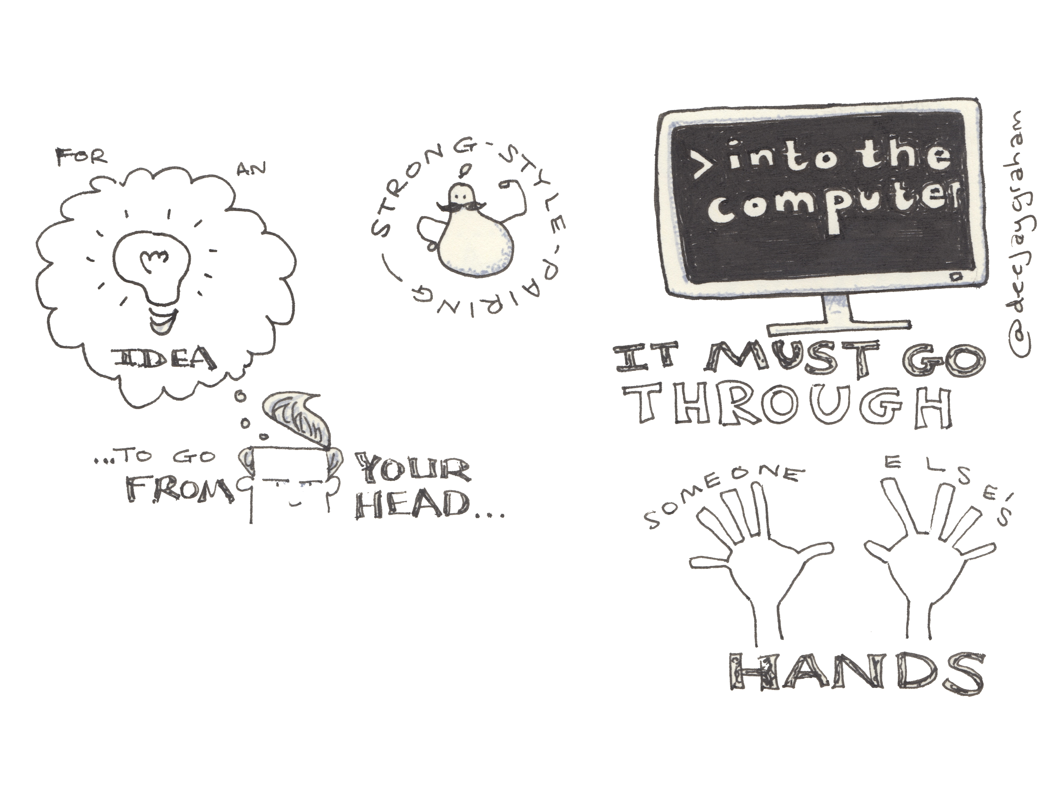
Notes:
states it like this
can be difficult to do,
first you will want to grab keyboard
sit on your hands and try to talk instead
code you produce is better quality.

Slide 79
“For an idea to go from
your head into the computer,
it MUST go through
someone else's hands.”
–Llewellyn Falco

Slide 80
Finding the right level
Abstractions
Language syntax
Files, line numbers
Key presses
Notes:
Is the Typist typing?
Do they look confused?
Talk at the right level for each person:
osmosis, rise up levels

Slide 81
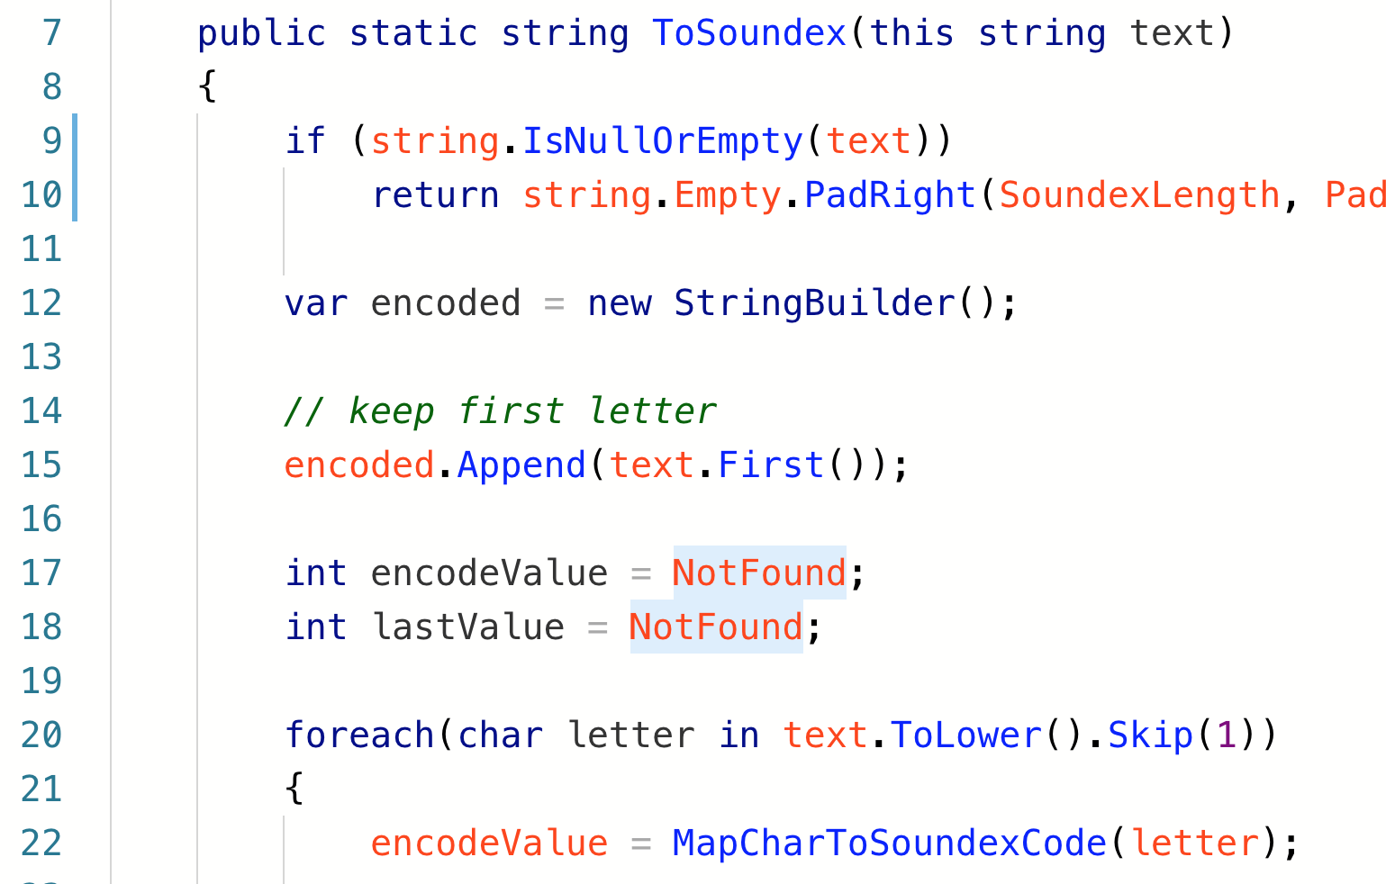
Notes:
Change line 15, split into two?
Could say something like - split that line into two
Or cut part in brackets insert into 14.5

Slide 82
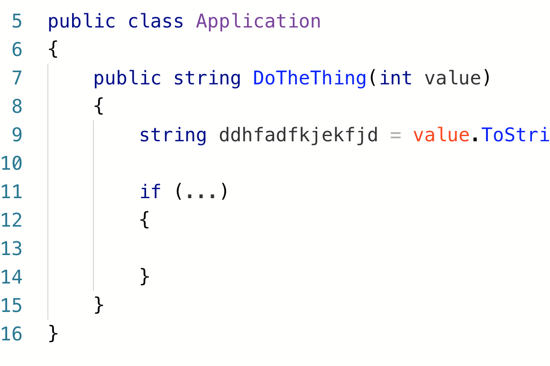
Notes:
Frequently a Mob will get stuck on naming. Give a variable an obviously wrong name to begin with until it gets beyond annoying, then agree on how it is being used. Better names.

Slide 83
When?
Notes:
Don’t give experts the keyboard at all

Slide 84
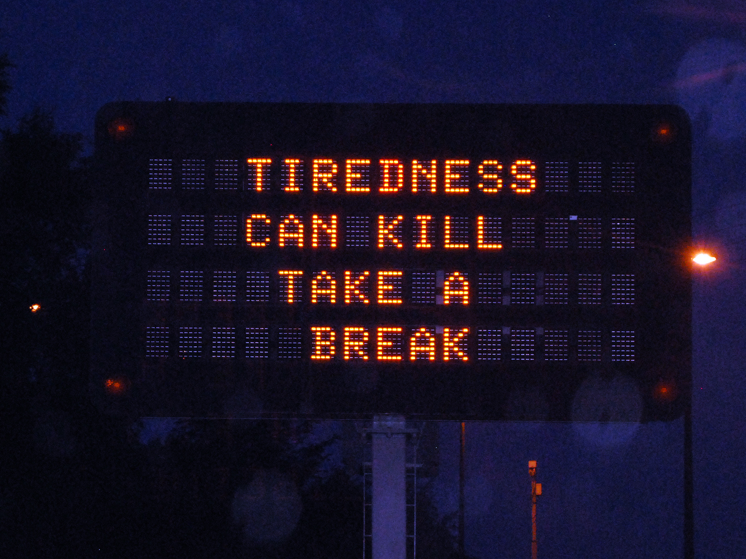

Slide 85
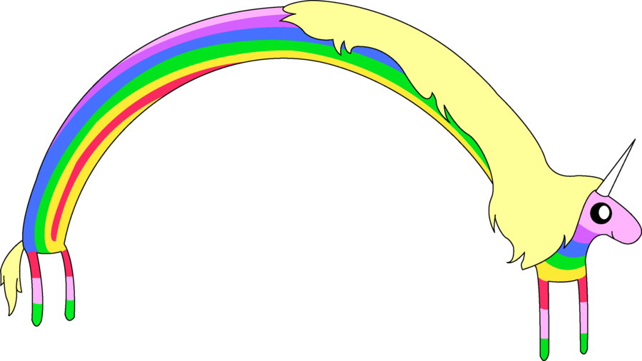
FUN!
Notes:
adventure time unicorns

Slide 86
When to…
Always :)
New work
Hard problems
Across Handoffs
Notes:
Code Merges?
Group learning
morning only, all day - cucumber team
adhocracy

Slide 87
When not to…
Sys admin and Dev Ops (pair instead)
Long running tasks
Small problems
J F D I
Notes:
headphones and crunch

Slide 88
Notes:
Example at a local meetup with Amitai Schleier last year. Awkward, lots of .net devs working in python, in an unfamiliar editor in front of their peers!!!
I had to be first volunteer, then I called on a friend then room kind of relaxed because no one could type with 30 people watching them.

Slide 89
Disagreements
& Uncertainty
Notes:
Often have times when way is not clear

Slide 90
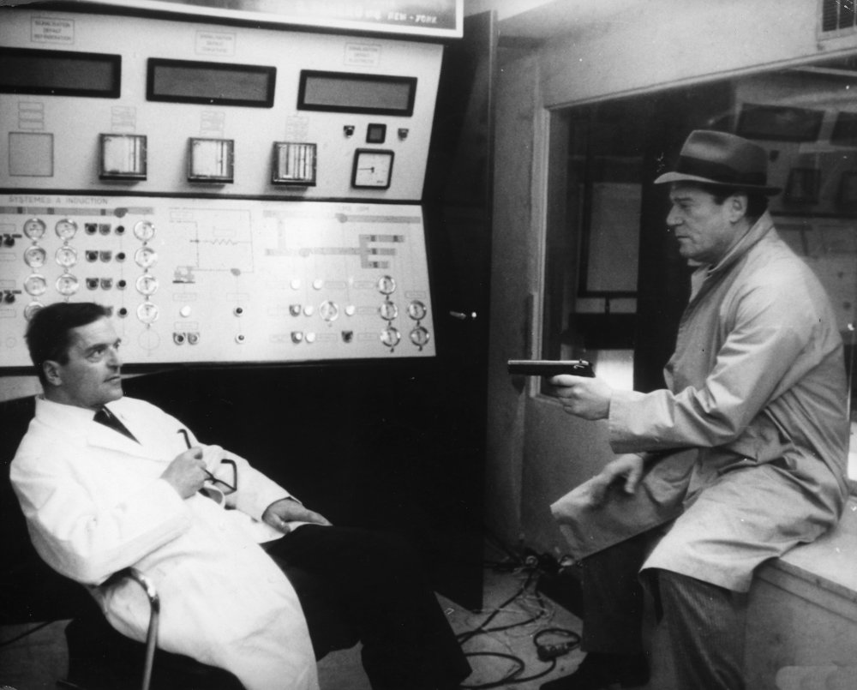
Notes:
time box - rollback
separate to poc spike
research
bring back together and present
decide as a group way forward

Slide 91
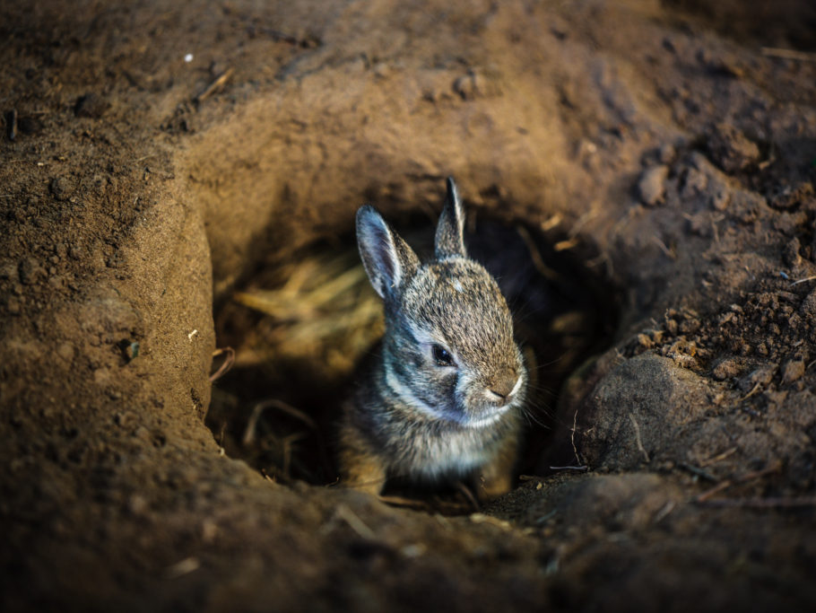

Slide 92


Slide 93
Inspect
& Adapt
Notes:
mentioned retrospectives earlier

Slide 94
Informal Huddle
As often as you need to:
How are we doing?
What is easy?
What is hard?
Notes:
at the end of the session, end of the day?

Slide 95
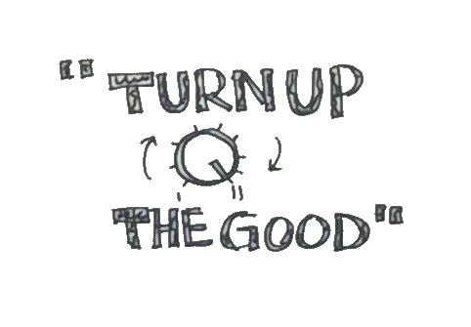

Slide 96
Turn up
the Good!
Notes:
concentrate on improvements,
don’t worry so much about what is wrong.

Slide 97
Resources

Slide 98
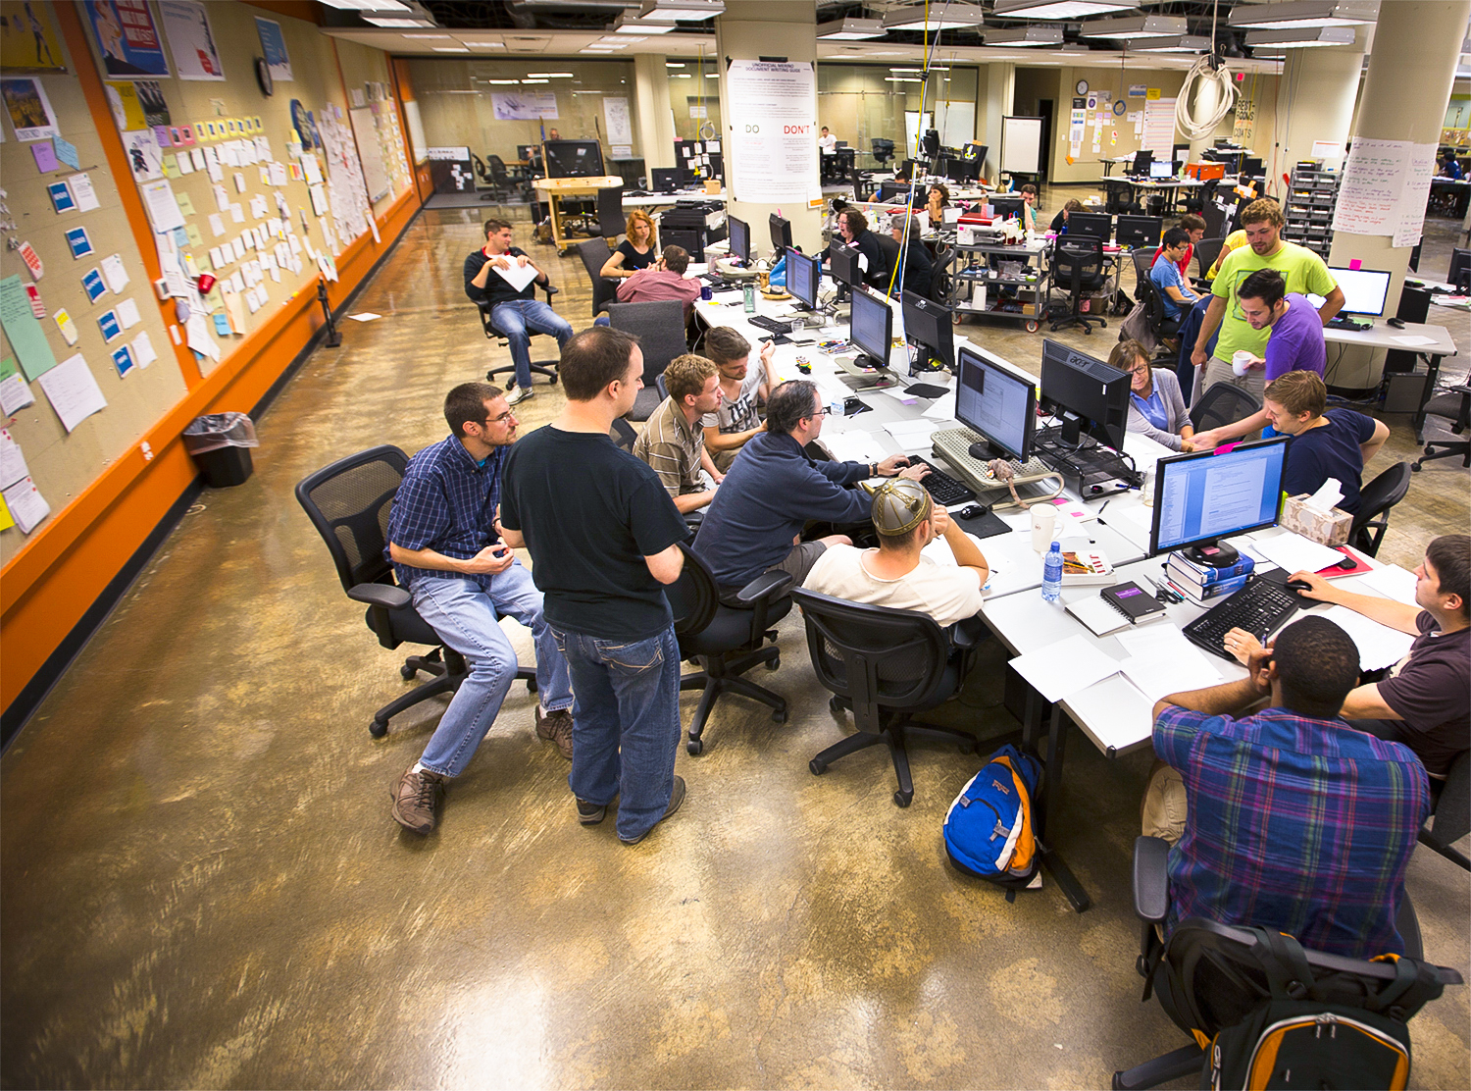
Mob-Positive Teams
Hunter Industries
Industrial Logic
Alaska Airlines
LateRooms.com
pluralsight.com
GDS (gov.uk)
Unruly Media
Blue Fruit
Menlo innovations
…and many more
Notes:
sage not included yet

Slide 99
Mobbing - http://mobprogramming.org
Woody Zuill - https://www.industriallogic.com
Chris Lucian - http://www.chrislucian.com/
mob timer - https://github.com/dillonkearns/mobster
Strong style pairing - https://llewellynfalco.blogspot.co.uk/
Amy Edmondson - https://hbr.org/2013/12/the-three-pillars-of-a-teaming-culture
Notes:
5 minutes

Slide 100
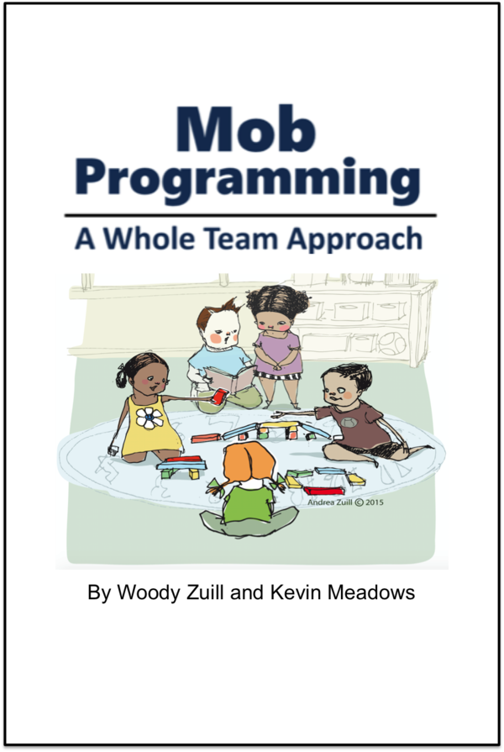
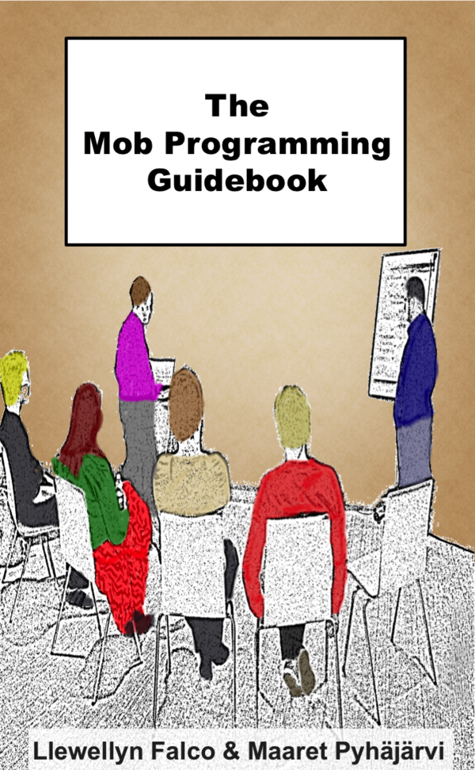
https://leanpub.com/mobprogramming
Notes:
Two different approaches - both worth looking at.

Slide 101
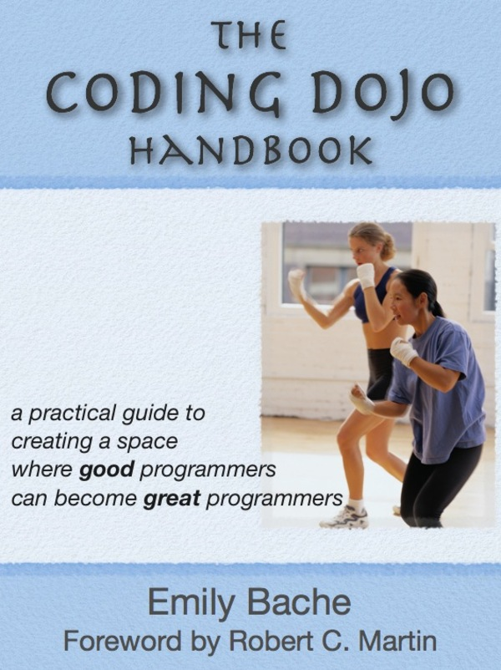
https://leanpub.com/codingdojohandbook

Slide 102
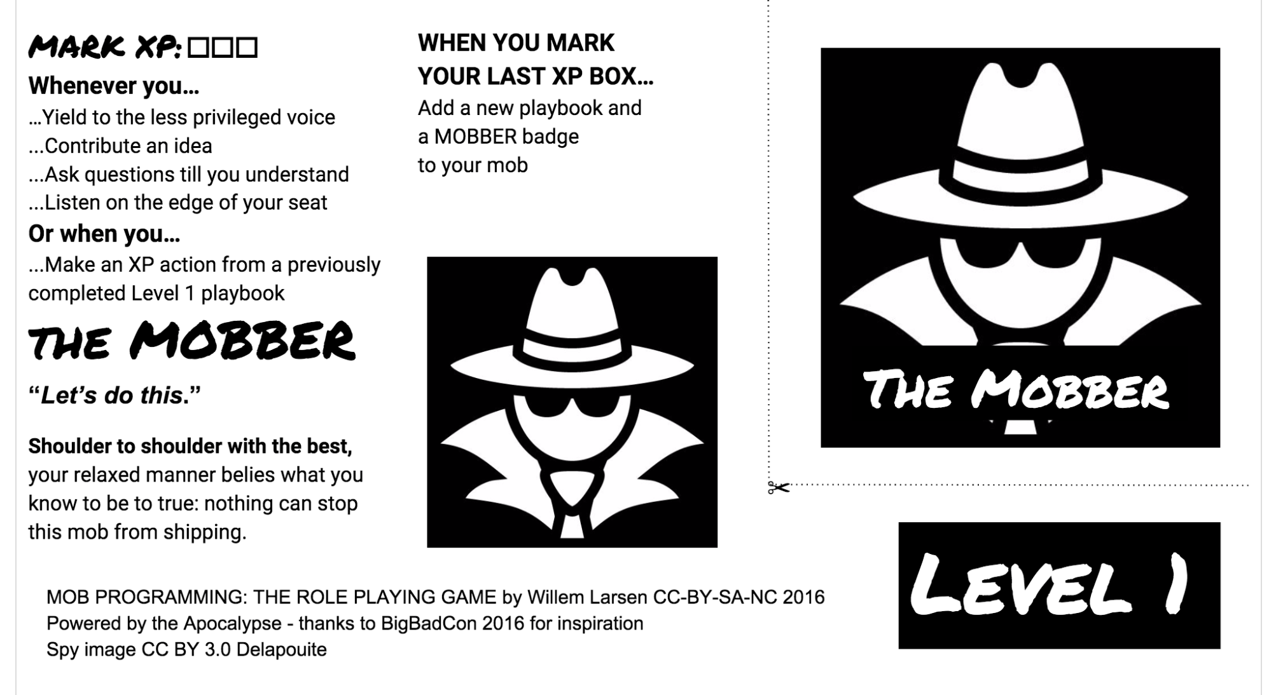
https://github.com/willemlarsen/mobprogrammingrpg

Slide 103
Problem Solving
Bray, R. M., Kerr, N. L., & Atkin, R. S. (1978). "Effects of group size, problem difficulty, and sex on group performance and member reactions." Journal of Personality and Social Psychology, 36, 1224-1240.

Slide 104
What can you take away?

Slide 105
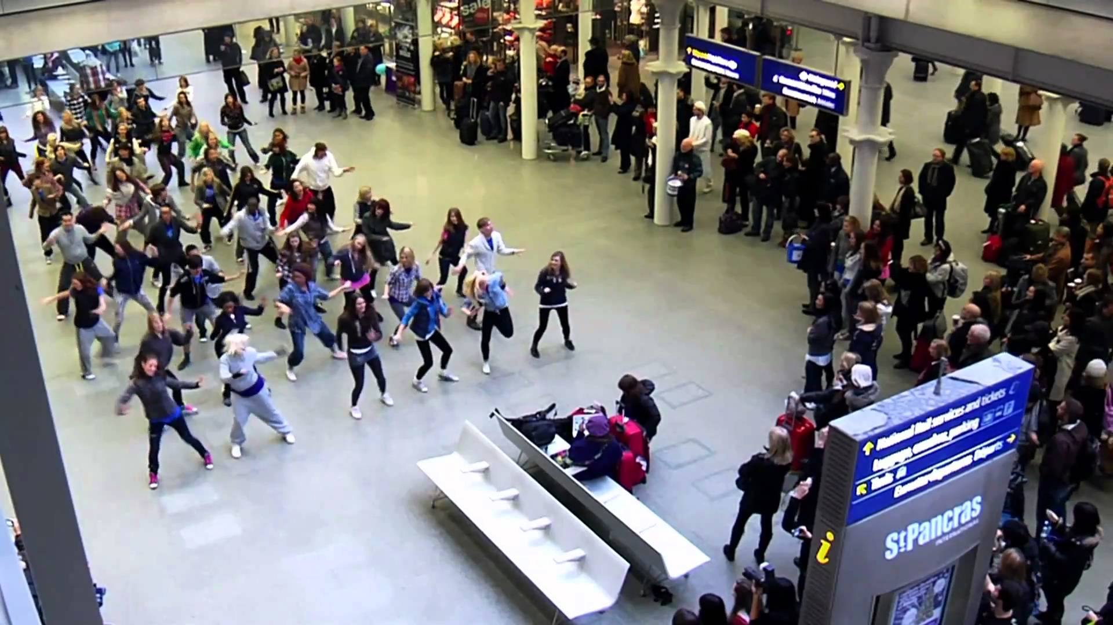
Experiment and discover what works for you
Expect to evolve
Culture change is hard
Flash Mob?
If nothing else…

Slide 106
<strong>
</strong>

Slide 107
What we noticed…
Code readability
Reduced Code Ambiguity
Improved Understanding
Testing was easier
Hard to hide bad code or tests
Reduced Truck Numbers
Notes:
Solo is faster but not for full lifecycle - incease quality

Slide 108
What we noticed…
Solo is faster (but not for full lifecycle)
Quality is better
“It’s our code”
Completed tasks
No standups necessary

Slide 109
What we noticed…
Loud
Communication is hard
Productivity slow at start
Scary coding and talking in front of others
Slow performance is obvious
Text Editor Wars

Slide 110
Notes:
I’ll stop blathering now and stop for questions.

Slide 111
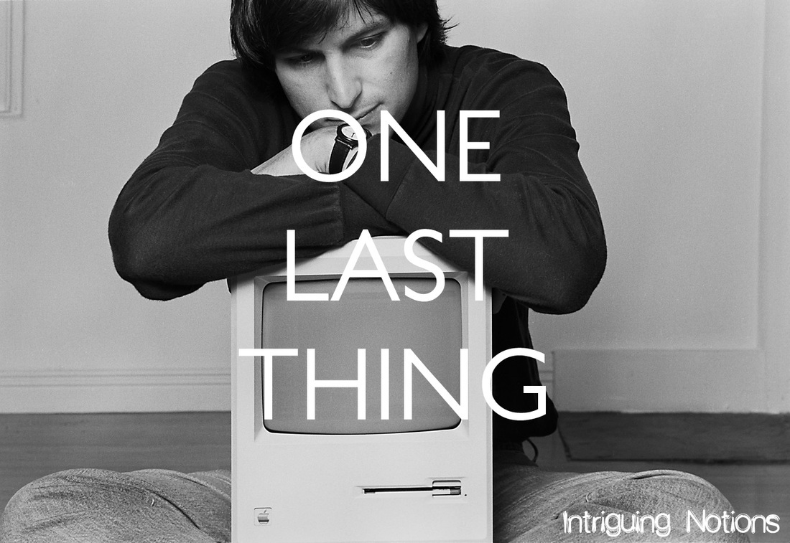
Notes:
feedback forms or feedback in person or on twitter. I find it very valuable so please share if you feel so moved.

Slide 112
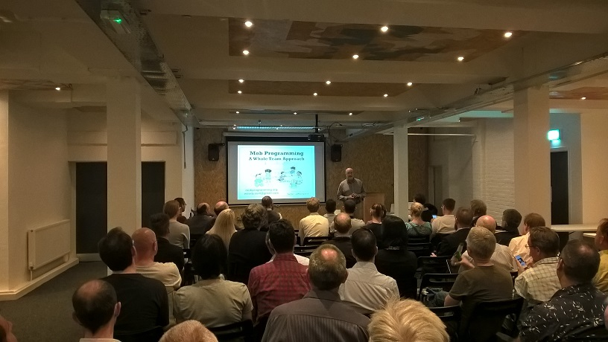
Notes:
Woody at CN in 2016
Back in July 2018

Slide 113
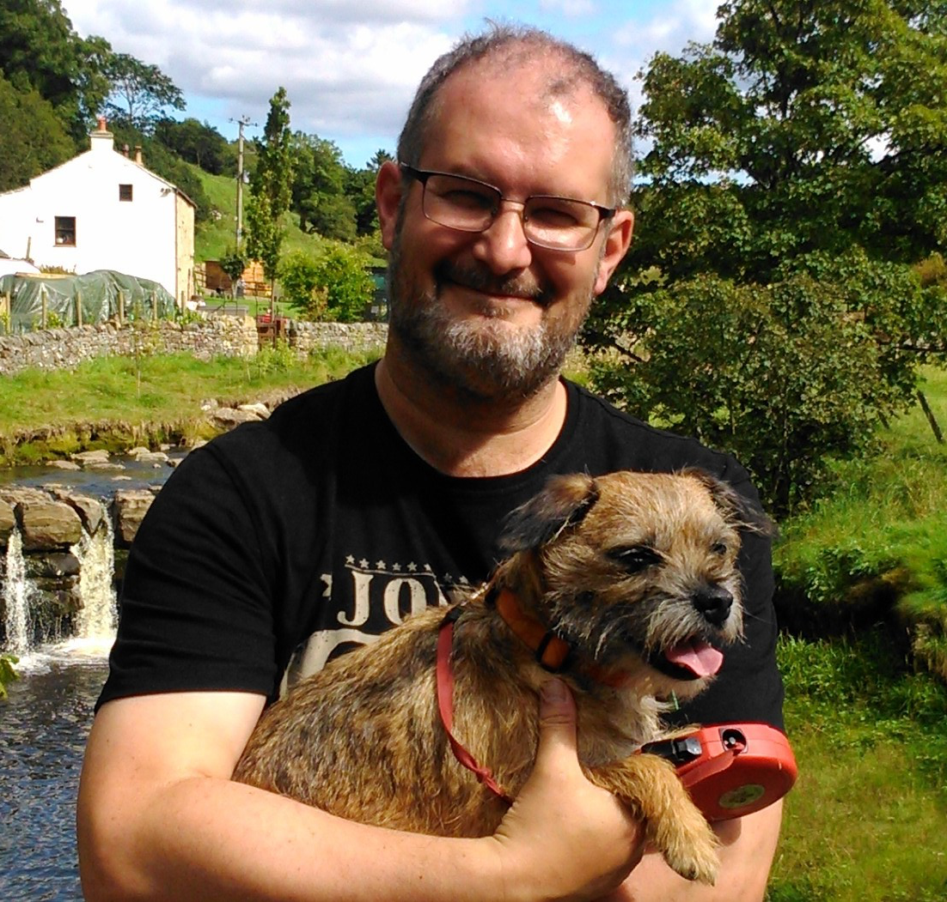
@deejaygraham
deejaygraham@icloud.com
deejaygraham.github.io
Notes:
Tweet slides at end.

Slide 114
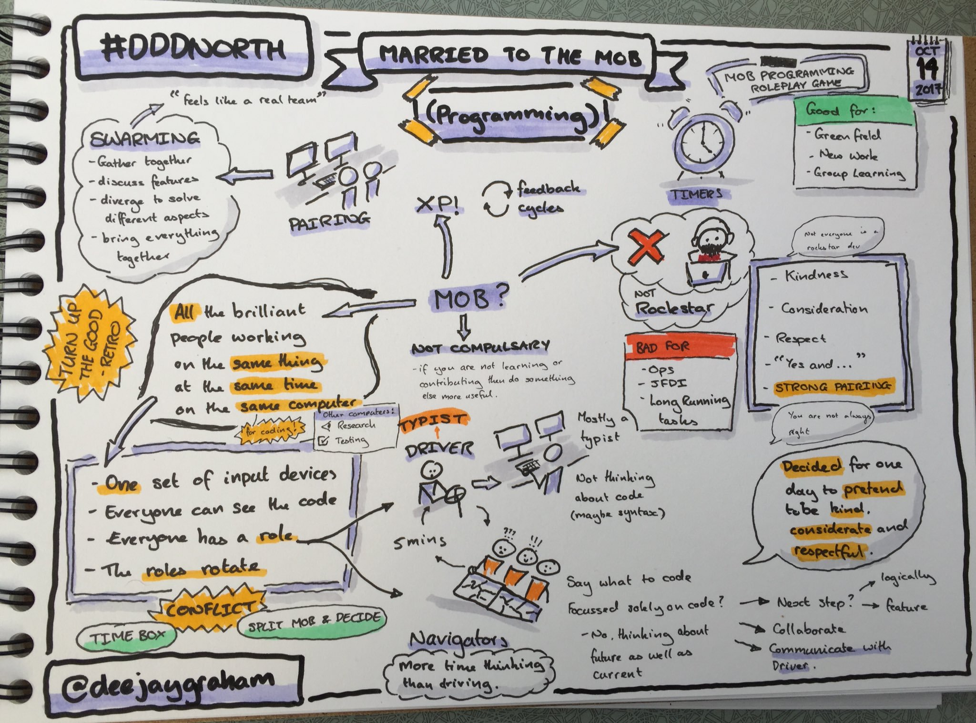

Slide 115


